Slide 1
Misophonia at school (and College)
Hosted by Shaylynn Hayes-Raymond, lct-c
Download the powerpoint: https://misophoniafoundation.com/shop/webinar-coping-with-misophonia-at-school-for-parents-of-teens-and-young-adults/

Slide 2
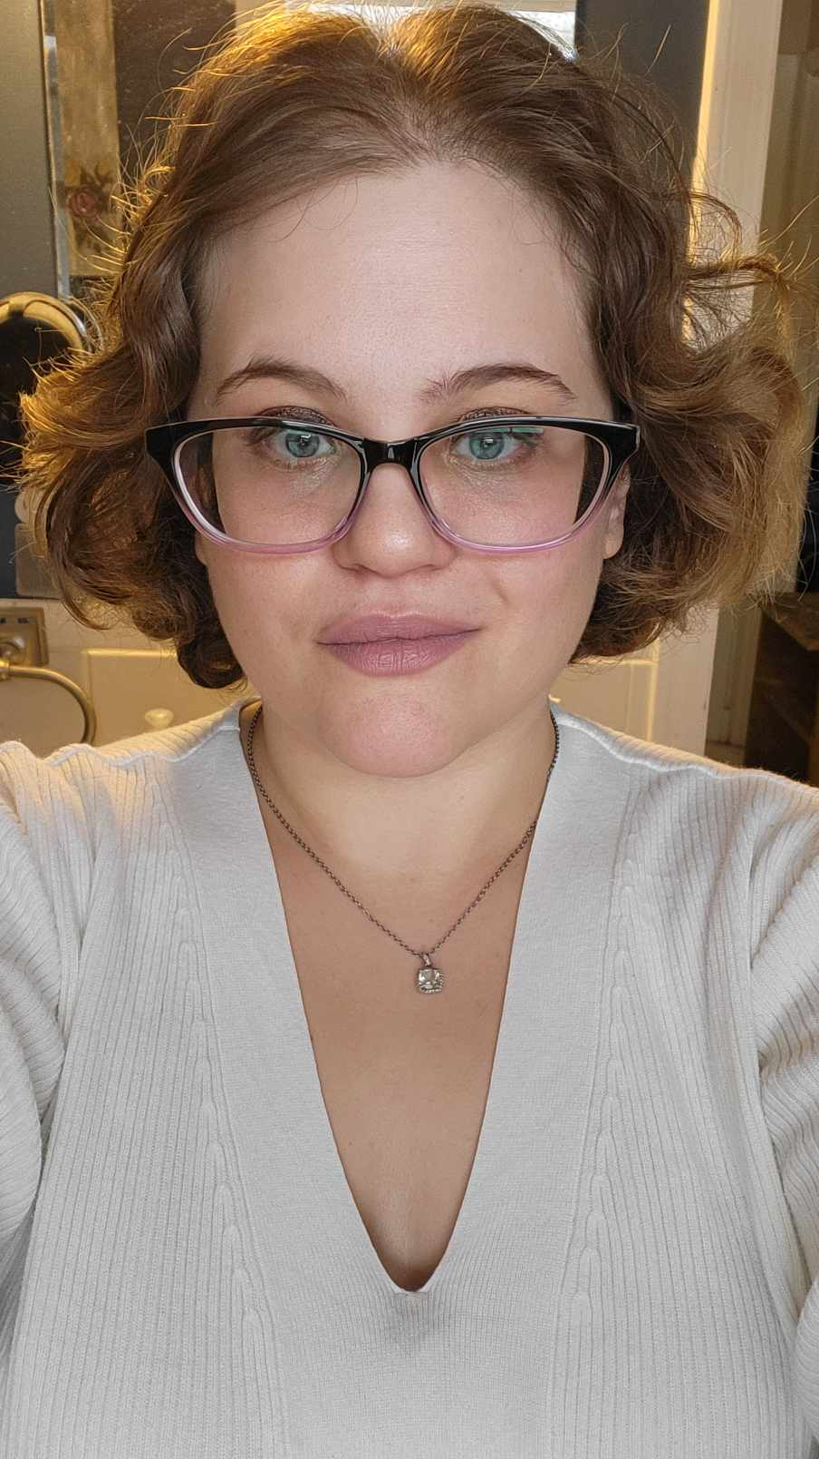
About Shaylynn Hayes-Raymond
My name is Shaylynn Hayes-Raymond and I have been a misophonia advocate since 2015.
I suffer from misophonia and misokinesia
Recent MACP graduate and LCT-C.
I am the director of the International Misophonia Foundation
- I have published numerous books on misophonia .
As a misophonia advocate, I have published in the following places, including: The Huffington Post, Different Brains, Physician’s Weekly, The Mighty, as well as many more.
I am the author of several fiction and non-fiction books including Misophonia Matters, Full of Sound and Fury: Living With Misophonia, Acceleration, How We Survive Ourselves, and the poetry anthology The World Breaks Everyone.

Slide 3
Misophonia Matters Class for Adults and Teens (On Demand)
Please note that this class does not include the clinician badge for our Clinician Directory. For the clinician course, please go here.
This class is a pre-recorded video. All questions can be sent via email. This class includes the Misophonia Matters ebook and Workbook (also in word format) digitally for free.
You can find your ebook and workbook in your downloads. The PDF slideshow is also included as part of this purchase. For questions related to this class, please email shaylynn@misophoniainternational.com directly.
This class is 1 hour long.
Once purchased, your account will be able to access the class at the following link: https://misophoniafoundation.com/misophonia-matters-class-on-demand/

Slide 4
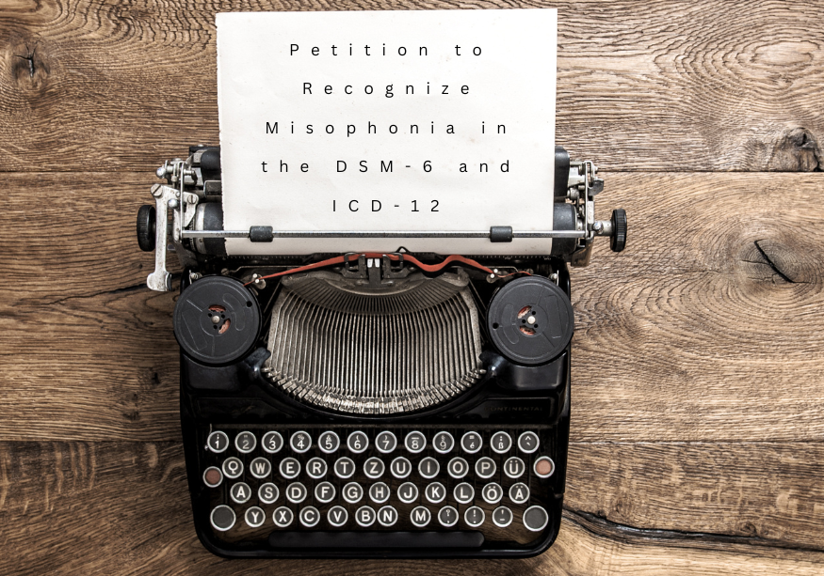
PETITION TO GET MISOPHONIA IN THE DSM/ICD
https://misophoniafoundation.com/petition-to-recognize-misophonia-in-the-dsm-6-and-icd-12/

Slide 5
Is Misophonia A Psychiatric Disorder ?
Jastreboff & Jastreboff (2001) had no intention of categorizing misophonia as a psychiatric disorder
They indicated that misophonia was an auditory/neurological disorder that had emotional consequences
Great confusion when this paper came out as other researchers and clinicians looked at misophonia from their own perspective
This is a problem in medicine in general
It is why working with a multidisciplinary team is best (audiologist, counselor, occupational therapist, etc.)
Press adds to the confusing (very few health editors anymore and proliferation of ideas on the internet)
Consensus now in small research community is that it is not a psychiatric disorder
Very important to address within educational community

Slide 6
What is Misophonia?
Misophonia research began with small samples and case studies. These kinds of studies are typical of the way researching a newly termed disorder begins
However, we have to be careful about what assumptions we make based on these studies
Early studies confirm that misophonia includes a neurological and physiological response to auditory and sometimes visual stimuli
These stimuli (sounds and sights) are “pattern based” (Jastreboff & Jastreboff, 2001)
We also see that sounds characterized by misophonia are also often repetitive
Examples: Chewing, tapping, coughing, the turn signal in a car
There has been an emphasis on “body or mouth sounds” emitted from other people. However, we have to consider that other peoples’ sounds are more salient
Example: Less likely to get angry with a “ticking clock” or the repetitive sound of the “turn signal” because it’s not personalized

Slide 7
What is Misophonia? (con).
Recent research suggests that individuals with misophonia differ in regard to brain connectivity, and physiological responses to trigger sounds (Kumar et al., 2017; Schröder et al., 2019). Dr. Danesh will cover this more.
In our literature review (Brout et al., 2018), we wrote: “Misophonia is a neurobehavioral syndrome phenotypically characterized by heightened autonomic nervous system arousal and negative emotional reactivity (e.g., irritation, anger, anxiety) in response to a decreased tolerance for specific sounds.”
Easier way to think about it again: The brain misinterprets sounds as toxic or threatening and sets off our survival system, better known as the fight/flight response

Slide 8
Fight/Flight Response & Auditory Gating
Fight/Flight: a neurophysiological response involving sweating, rapid heartbeat, and hormonal changes (among other physical changes) that is catalyzed by exposure to stimuli perceived as harmful, in which our body prepares us to “fight” or flee from danger (Goldstein, 2010).
Problem in misophonia is that this automatic reaction happens within milliseconds, and this is why behavior modification plans don’t work (teacher may try to focus on what is familiar and logical to them, and how they have been trained).
Another aspect of misophonia may be related to auditory gating
Example: Watching a sleeping dog pricks up ears in reaction to sound (alerting)
Brain goes through subconscious or preconscious process determining if a threat exists
In reaction dog will do three things:
Nothing and fall back to sleep
Hide (flee)
Bark (fight)
“The gate doesn’t close” and allow these sounds to dissipate into the background. Rather than attention and reactivity decreasing as sounds are put into the background, an individual becomes more alert and more reactive as the sound repeats. Picture an upward line on a graph rather than a downward line (Davies & Gavin, 2007).

Slide 9
Misophonia Treatment
We hear a lot about CBT, exposure therapy and numerous other ideas about potential treatments
Treatment research has just started
Teachers, like any professional in education, health or mental health may suggest a treatment based on their perspective
Often use behaviorist principles & these mostly do not work

Slide 10
MisoKinesia
Suggested by Schroder, et al. (2013;2018)
Visuals
Movement
Repetition
Association

Slide 11
Concerns at School
Dealing with the school can be difficult in regard to any unknown disorder
Often helpful for parent to reach out and/or for clinician to reach out to provide an easily understandable explanation for misophonia and to explain necessary accommodations in terms specific to the student
Again…the brain misinterprets sounds as toxic or threatening and sets off our survival system, better known as the fight/flight response
Advocating for your child; requires persistence and patience (the variability of an individual’s reactivity may vary from day to day, or class to class)
For example, school lunches can be very stressful for some students with misophonia (or even on some days and not others for some individuals)
Alternatively, some individuals find the loudness of the cafeteria better than other places because the quieter repetitive sounds may be masked
Level of reactivity can be highly variable in just one individual because misophonia is mediated by general health and other stressors – this is very confusing and somewhat misrepresented in the literature

Slide 12
School Activities
Encourage your child to join activities that interest them and in which the activity itself decreases nervous system reactivity
This is different for every child or teenager
Often during movement (walking or just sports) reactivity is lower
You may notice that when your child is moving around (i.e. outside) reactivity is decreased
All the senses work together to some degree, movement changes the processing of sound
Acoustics may also come into play
Speak to the teacher or parent in charge of the school activity about misophonia, bring documentation such as a letter from your child’s therapist, or the doctor’s guide provided on the Misophonia International website
Do not force your child to stay in an activity if it is becoming too stressful; remember, the lower your child’s overall stress, the easier it is to manage Misophonia.
Encourage activities and hobbies outside of school if there are no school activities your child wants to engage in

Slide 13
School Trips
Students with misophonia often have trouble with car rides
If possible, arrange for alternative travel arrangements for your child (although this is not always possible (i.e. driving your child and meeting up with the rest of the group)
Unfortunately, it can be very hard to accommodate trips, and some trips might not be possible for the child (such as a movie trip if your child is reactive in theatres).
Comfort your child if they feel left out and consider arranging something you can do together that day, such as visiting a zoo or whatever activity you feel is appropriate

Slide 14
Bullying
Some misophonic students have experienced other children bullying.
However, this is very disheartening for the student, and can lead to an even greater aversion to school
Note, this is certainly not typical, but unfortunately it does happen with misophonia as it does with other disabilities and disorders
Discuss the problem of bullying with school administrators and teachers
Bring documentation to explain the various impacts of the misophonia.
Suggest ways to advocate for misophonia at your child’s school.
Ask for a student advocate if necessary
In many states other parents who have children with special needs volunteer to advocate
Some volunteer advocates may even go to school meetings with you

Slide 15
Possible Accommodations
Parents, practitioners, teachers and school administration can work together to find what works best for the student (without impeding other students)
Assigned seating where student is comfortable to reduce anxiety of finding their “preferred seat”
Frequent breaks
Earplugs, white-noise or sound generators, and headphones
Alternative assignments for absences
Testing and exams in a separate room

Slide 16
College
Parents often wonder if their “misophonic” child will be able to successfully attend post-secondary education, in many cases, this is easier than prior education.
Some students do well on-campus, with the freedom to choose their own class schedules, course-load, and courses interesting to them.
While the college curriculum may be more difficult, students are typically going to classes all day, without breaks (and in one building).
For students that are unable to flourish on-campus, there are now numerous options for “distance education” for Bachelor’s, Masters’, and now even some PhD programs.
College offers many opportunities for students to learn at their own pace and is less rigid than elementary to high school programs.
There are numerous choices for program and course types (seminars, video e-learning, and e-texts), which can accommodate several different student needs.

Slide 17
Advocating in College
By college many students are able to advocate on their own and share information, some are not and it is appropriate for parents to be supportive and involved (especially the first year)
Know that college personnel are only allowed to speak to you about your child (age 18 and up in U.S.)
This is an effort ( law in U.S.) to protect your child’s privacy. However, FERPA form (The Family Educational Rights and Privacy Act, 1974) can be used for your child to waive this privacy allowing you to be involved. Absolutely nothing wrong with, especially first year
Another option is to have therapist in touch with college if the family is comfortable with that

Slide 18
More Options Today
Some districts now have the possibility for taking some classes online, even high school.
Programs for online colleges and programs are becoming more abundant and affordable.
You and your child (or teen/young adult) should not feel ashamed of taking advantage of these options of necessary
Don’t panic if your child needs this one year. They may not need it next year

Slide 19
Tips for Teachers
Work with parents and clinicians to meet the needs of individual students
While it is often not possible to pay attention to one student, be mindful of misophonic students’ needs, and be empathetic when approached.
Do not feel like you need to “solve” the problem, just be supportive of the student
Understand that students are not asking for headphones and breaks for leisure, and that these conveniences are helping them to remain calm and prevent meltdowns and shutdowns
Understand that the child or teenager is not acting out for attention, but rather, due to an over-aroused nervous system.
Remain in touch with parents and counsellors in regard to meltdowns and shutdowns in class and consider whether alternative arrangements might be better for the student
Read academic reviews and papers
Do not make assumptions about the the individual with misophonia without understanding the available research

Slide 20
Tips for Parents (What to Do if a Teacher Does Not Understand Misophonia)
Try to work with teachers, principal or school nurse when your child is having difficulty. Often finding one advocate within the school makes a very big difference (and one never knows who that person may be).
Don’t expect teachers, or school personnel to know about misophonia
Try to be patient with teachers, etc. It is not the teacher or administrator’s fault that this disorder has just come to light
However, teachers, etc. should certainly be willing to listen to you (parents) about their child
While it is frustrating, educating your child’s teacher, or school is the best path to get help
As Dr. Danesh’s study supports, information is key

Slide 21
Tips for Parents (con.)
Often it is easier for both parents and school personnel if parent refers teacher to reading material
It is best to give a “quick read” version of misophonia along with academic literature (such as a recent literature review)
Bring printed materials such as the free guide for doctors (link here, and at the end of presentation).
Provide documentation and letters from your child’s personal counsellors and clinicians.
Try not to be too discouraged, while information on misophonia is growing, there are still many who have never heard of the disorder.

Slide 22
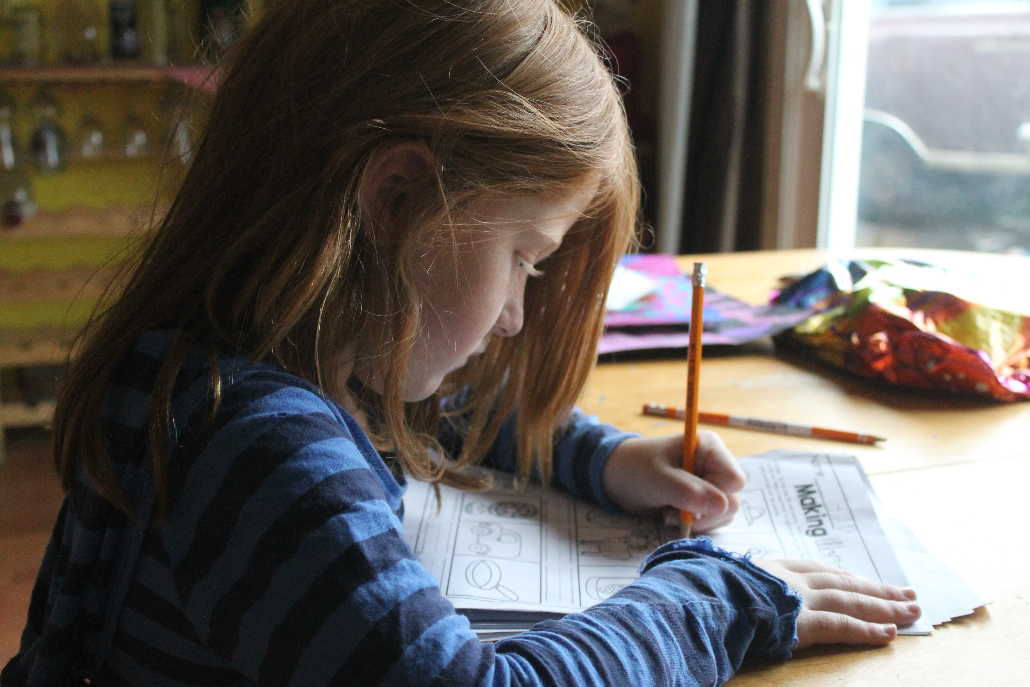
Tips for Homework
Ensure your child has a quiet/comfortable place to complete their homework and assignments
Ensure your child has the appropriate time to calm down and is “regulated” before doing homework
Often physical activity prior to home is helpful and/or relaxation exercises
Occupational Thearpists can be very helpful in terms of assessing how to self-regulate before, during and after homework (misophonia not spd but some individuals have both OT’s know a great deal self-regulation based on physiology

Slide 23
Tips for Clinicians
Support patients by creating specialized accommodation plans. No child is the same, misophonic children included.
Understand that some accommodations might be difficult in a school setting (other students might need to eat in class/chew gum due to health, learning or developmental conditions), and work with parents and teachers to find common ground when possible.
Also, utilize education (downloads, literature reviews, etc.) when discussing misophonia with teachers, etc.
Have a working knowledge that allows you to briefly explain the disorder and how it affects each individual, or interacts with other issues the individual may have. This is a key point that I have repeated several times. Parents depend upon therapists, etc. to help them come up with a simple yet accurate description of misophonia

Slide 24
You and Your Child are Your Best Advocates
Nobody understands your child’s needs better than you and your child.
Advocacy is an on-going process, and will likely be important through primary school to the workplace.
It is important that your child is knowledgeable about the disorder and able to calmly explain misophonia without “lashing out” or accusing the “offender”. This takes psychoeducation and skill building
There will always be somebody who doesn’t “get” misophonia or understand the disorder. Instead of being angry or discouraged, first try to calmly explain misophonia and its adverse effects.
The best way to increase knowledge on misophonia is to share information!

Slide 25
Misophonia Coping Skills Coaching
What the Coaching Program Entails This program is suitable for teens, young adults, and adults with misophonia.
This package includes 8 coaching sessions with Shaylynn Hayes-Raymond. Coaching sessions are NOT therapy sessions. All coaching sessions are offered as an experience-based skills building session, and do not have the same goals as therapeutic relationships. This is pre-pay only. This package is limited to space and availability. These sessions are designed to last 2 months with 1 appointment per week on the same day/time each week. Cost $1000 USD for 8 coaching sessions Taxes and fees not included. If you need to reschedule one of the sessions please do so 48 hours before-hand. Session 1: Initial appointment. Psychoeducation mixed with learning about the client. Session 2: Misophonia self-assessment followed by debriefing and seeing the client’s perspective on the assessment. Session 3: More psychoeducation/skills building with cognitive and sensory-based strategies. Session 4, 5, 6, & 7: More focus on coping skills, building strategies, and the sensory diet. Session 8: Misophonia assessment and debriefing on the coaching process. This coaching program is offered worldwide through Zoom. https://shaylynnraymond.com/misophonia-coaching/

Slide 26
References
Brout, J., Edelstein, M., Erfanian, M., Mannino, M., Miller, L.J., Rouw, R.,...Rosenthal, M.Z. (2018). Investigating misophonia: A review of the empirical literature, clinical implications, and a research agenda. Frontiers in Neuroscience, 12(36), 1-13. doi:10.3389/fnins2018.00036.
Davies, P.L., & Gavin, W.J. (2007). Validating the diagnosis of sensory processing disorders using EEG technology. Am. J. Occup. Ther., 61, 176-189. doi:10.5014/ajot.61.2.176.
Goldstein, D.S. (2010). Adrenal responses to stress. Cell. Mol. Neurobiol., 30(8), 1433-1440. doi:10.1007/s10571-010-9606-9.
Jastreboff, M.M., & Jastreboff, P.J. (2001). Components of decreased sound tolerance: hyperacusis, misophonia, phonophobia. ITHS News Lett., 2, 5-7.
Kumar, S., Hancock, O.T., Sedley, W., Winston, J.S., Callaghan, M.F., Allen, M.,...Griffiths, T.D. (2017). The brain basis for misophonia. Curr. Biology, 27, 527-533. doi:10.1016/j.cub.2016.12.048.
Porcaro, C.K., Alavai, E., Gollery, T., & Danesh, A. (2019). Misophonia: Awareness and responsiveness among academics. Journal of Postsecondary Education and Disability, 32(2), 107-118.
Rouw, R., & Erfanian, M. (2018). A large-scale study of misophonia. Journal of Clinical Psychology, 74(3), 453-479. doi:10.1002/jclp.22500.
Schröder, A., van Wingen, G., Eijsker, N., San Giorgi, R., Vulink, N.C., Turbyne, C., & Denys, D. (2019). Misophonia is associated with altered brain activity in the auditory cortex and salience network. Scientific Reports, 9(7542), 1-9. doi:10.1038/s41598-019-44084-4.
Simonetti, P., & Oiticica, J. (2015). Tinnitus neural mechanisms and structural changes in the brain: The contribution of neuroimaging research. Int. Arch. Otorhinolaryngol., 19, 259-265. doi:10.1055/s-0035-1548671.

